Slide 1


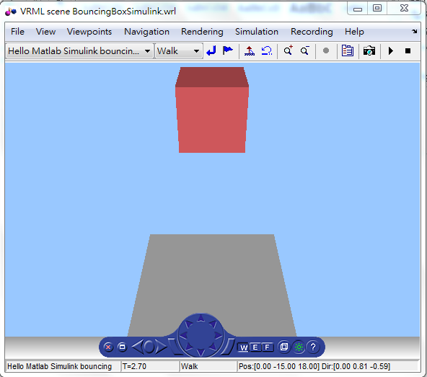
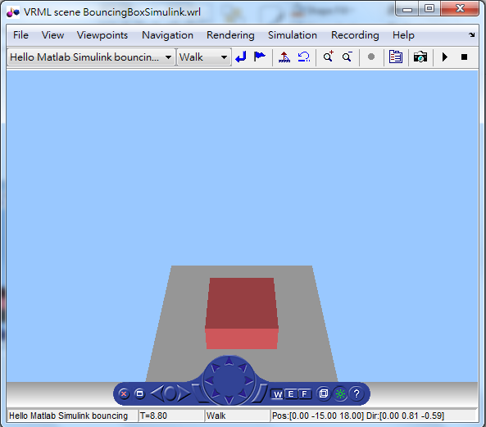
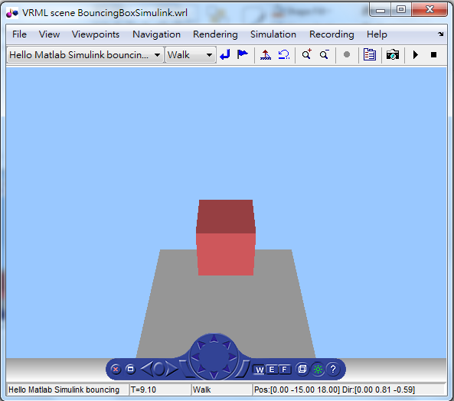
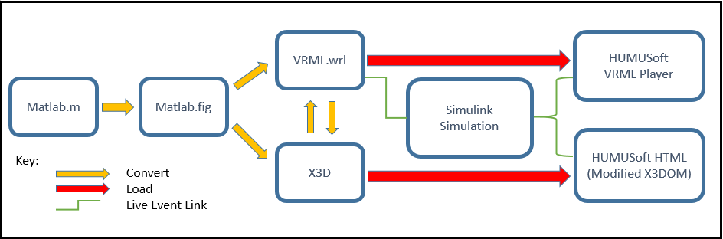
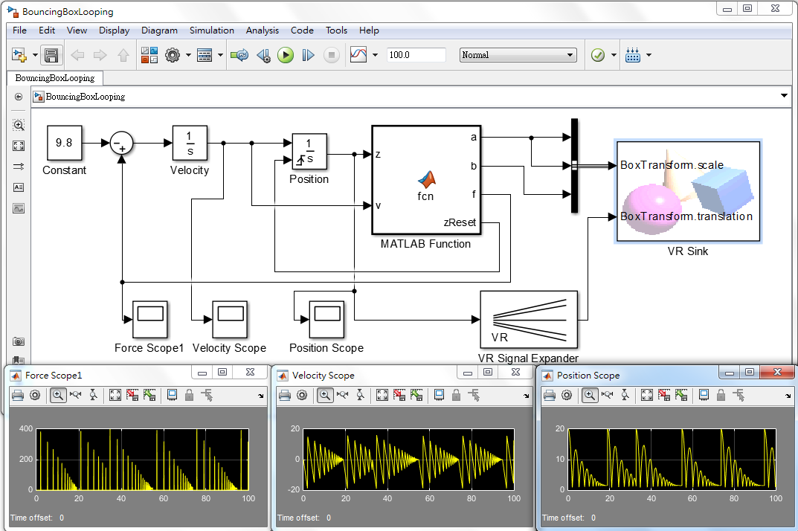
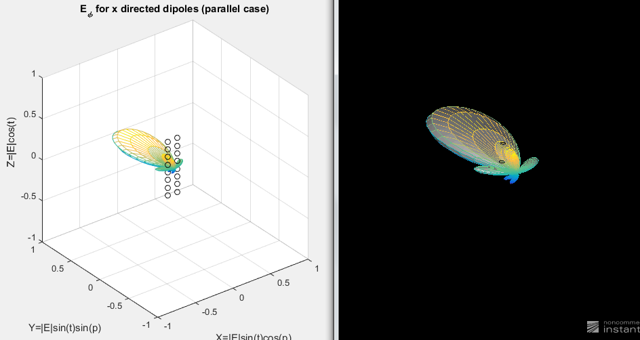
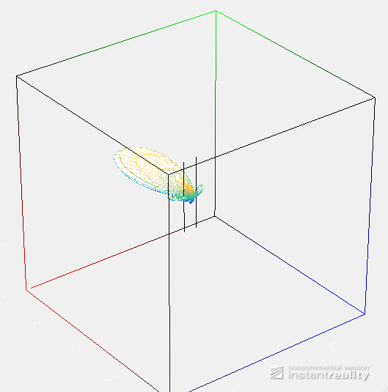
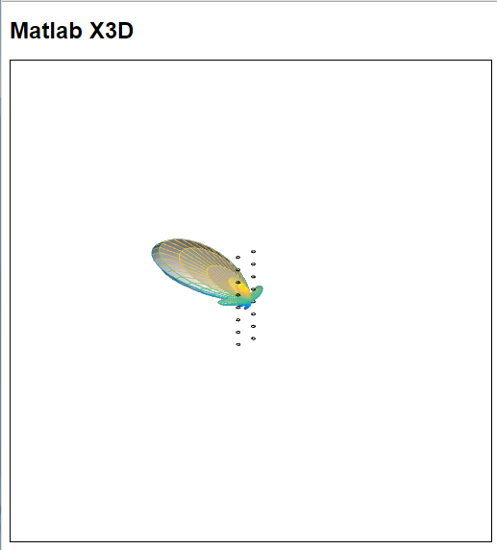
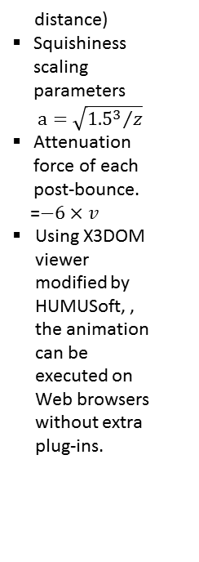
Matlab and Simulink Creation and Animation of X3D in Web-Based Simulation
YuanPin Cheng and Don Brutzman, ycheng and brutzman@nps.edu
Abstract
Matlab is a powerful tool to compute high-fidelity engineering model and plot the result in figures. Simulink implements Matlab .m source code into block diagrams and flow charts to execute the simulation. This project demonstrates how physics equations implemented in Simulink can animate X3D or VRML models, along with the methods to convert Matlab .fig format into an X3D object so we can apply it into Web-based animations
Matlab/Simulink Animation of X3D Models
In the bouncing box model, Simulink block diagram “MATLAB Function” constantly computes the movement of the red cube by following parameters:
The cube position “z”. It is applied by free-fall dynamic equations with G-force, “Constant = 9.8”.
Implementing Hooke’s Law as the resilient force “f” during the cubes’ collision of ground. (f = -kX, k = 600 is a constant factor characteristic of the spring, X is the cube compression
High-Fidelity Engineering Model Application
Matlab is capable to implement complex physics equations or models and graph the result. In this demonstration, we calculated a phased-array antenna radiation pattern from Matlab and then converted it in to Web-based 3D models, such as .wrl, .x3d scenes for further application.
distance)
Squishiness scaling parameters$a=\sqrt{{{1.5}^{3}}/z}$
Attenuation force of each post-bounce.
=$−6×v$
Using X3DOM viewer modified by HUMUSoft, , the animation can be executed on Web browsers without extra plug-ins.
Bouncing Cube Animation
Free Fall
Compression
Post-Bounce
Block Diagram of Simulink Animation
Converting Steps
Positon
Velocity
Force Variation
References
HUMUSOFT, MathWorks, Simulink 3D Animation Examples.
http://www.mathworks.com/help/sl3d/examples/bouncing-ball.html
Don Brutzman, X3D for Advanced Modeling Examples Archive. http://x3dgraphics.com/examples/X3dForAdvancedModeling/Matlab
a 3D Pattern Created in Matlab .m Source
Matlab .m Converted to .x3d Model
Matlab .m Converted to .wrl Model
Matlab .m Converted to .HTML Model

